Slide 1
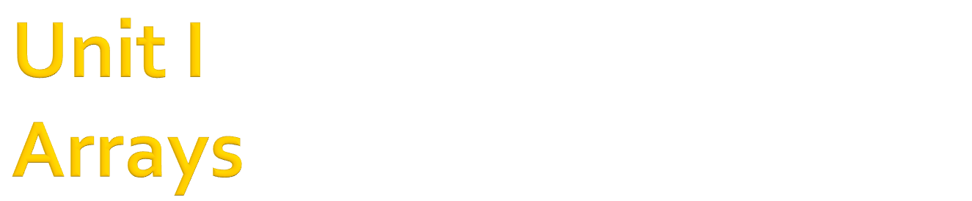

Slide 2

Arrays can hold sets of data of the same type.
An array has a name and the values stored in it can be accessed by an index.
The indexing of arrays starts at zero and you cannot change this behavior.
Arrays can be multi-dimensional
  One-dimensional
  Two-dimensional, etc

Slide 3

Arrays must be declared with the Dim statement followed by the name of the array and the index of the last element in the array in parentheses
Syntax:
Dim <array_name(upper_index)> As Datatype
Example:
Dim rollNo(9) As Integer
(0) | (1) | (2) | (3) | (4) | (5) | (6) | (7) | (8) | (9)
rollNo

Slide 4

When we want to provide values during declaration to an array, we have to make sure that we do not specify the upper limit or upper bound index
The (number of values specified – 1) will be taken as the upper limit for the array by the compiler
Syntax:
Dim <array_name()> As Datatype = {value1, value2, value3, value4,….,value N}
Example:
  Dim rollNo() As Integer={101,202,12,67,34}
  Thus, upper_limit is taken as 4

Slide 5

To access array elements, we make use of the array name along with index value
To add value to an array:
  Syntax: array_name(index) = <value>
To get value from an array:
  Syntax: <variable_name>= array_name(index)
Note**:
  Both <value> & <variable_name> must of the same datatype as that of the array

Slide 6

If we do not how large an array should be, we can determine its size later during the course of the program. Such an array can be declared as a dynamic array.
A dynamic array can be declared as follows: Syntax:
Dim <array_name( )> As Integer
Thus, we are able to declare an array of any dimension without specifying its size as well as without initializing it
But, before such an array can be used, we have to set its dimension by using the Redim Statement

Slide 7

Later in the program, when we know how many elements we want to store in the array, we can use this statement to redimension the array to its actual size.
Syntax:
ReDim <array_name(upper_index)
  where size can also be a user-entered value.
Note**
  The Redim Statement can appear only in a procedure as it is an executable statement
  This is not the case of Dim Statement.

Slide 8

Each time we execute the ReDim Statement, all the values currently stored in the array are lost.
ReDim Statement: resets numeric elements to zero and String elements to empty strings.
If we need to resize the array without discarding the existing data, we can use the Preserve keyword.
Syntax:
ReDim Preserve <array_name(new_size)>
Example:
ReDim Preserve num(UBound(num) + 1)
Note**
  UBound() function returns the largest available index in a one-dimensional array.

Slide 9

A two-dimensional array has two indices. The first identifies the row and the second identifies the column.
Syntax for declaration:
Dim <array_name(row,column)> As Datatype
Example:
  Dim num(2,9) As Integer
  Here, we have 3 rows and 10 columns
num
 | (0) | (1) | (2) | (3) | (4) | (5) | (6) | (7) | (8) | (9)
(0) | (0,0) | (0,1)
(1) |  |  |  |  |  | (1,5)
(2) |  |  |  |  |  |  |  |  |  | (2,9)

Slide 10

To initialize a two-dimensional array during declaration, we again do not require to provide the row and column values
The values are specified row-wise i.e. first row values followed by second row values, etc.
Each row-values are enclosed separated by common
Syntax:
Dim <array_name(,)> As Datatype= {{row1-values},{row2- values},…..{rowN-values}}
Example:
  Dim num(,) As Integer={{1,2,6} , {3,4,7}} ‘rows=2, columns=3
  For declaring this array: Dim num(1,2) As Integer

Slide 11
To access array elements, we make use of the array name along with row and column index value
To add value to an array:
  Syntax: array_name(row,column) = <value>
To get value from an array:
  Syntax: <variable_name>= array_name(row,column)
Note**:
  Both <value> & <variable_name> must of the same datatype as that of the array

Slide 12

There can be a three-dimensional array also which is like a cube made up of overlaid two-dimensional arrays.
A three-dimensional array has three indices.
Example:
Dim num(1,2,3) As Integer

Slide 13
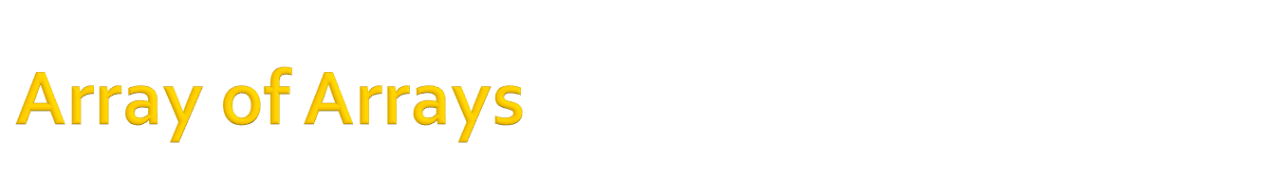
If an array is declared as Object, we can assign other types to its elements, including arrays.
Example:
Dim arr1(4) As Integer
Dim arr2(4) As Integer
Dim BigArray (1) As Object
Dim i,k As Integer
k=6
For i = 0 to 4
arr1(i) = i+1
Next
For i = 0 to 4
arr2(i) = k
k=k+1
Next
BigArray(0) = arr1
BigArray(1) = arr2
MsgBox(BigArray(0)(1))
1 | 2 | 3 | 4 | 5
arr1
6 | 7 | 8 | 9 | 10
arr2
[[0]
[[1]
1 | 2 | 3 | 4 | 5 | 6 | 7 | 8 | 9 | 10
BigArray

Slide 14
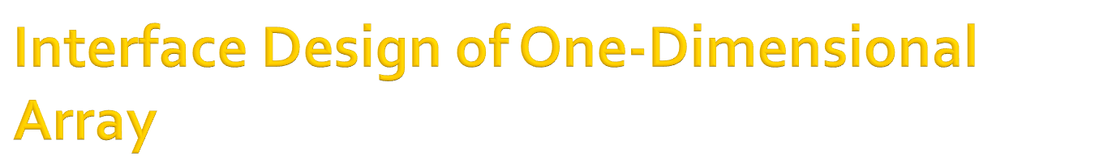
We would like the design to reflect the actions taken by the user.
The GUI must have features to enable user to take size of the array, the numbers upto the specified size and then display the array when the user has entered the last element
Sample GUI is shpwn below

Slide 15

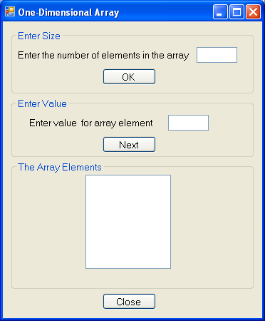

Slide 16

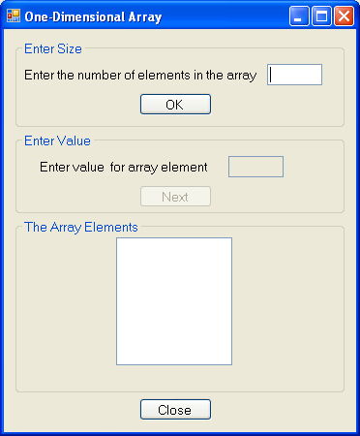
Disabled done in the
Form Load Event

Slide 17

We make use of the Form Load Event. (Just double-click on the form)
The code behind the event will be executed when the you run the application.
Example:
Public Class Form1
Private Sub Form1_Load(ByVal sender As System.Object,
ByVal e As System.EventArgs) Handles MyBase.Load
txtValue.Enabled = False
btnNext.Enabled = False
txtNo.Focus()
End Sub
End Class

Slide 18

Public Class Form1
‘declaration of variables to be accessed in any subprogram of the Form
Dim arr() , n ,i As Integer
Private Sub btnOk_Click(ByVal sender As System.Object, ByVal e As
System.EventArgs) Handles btnOk.Click
n = txtNo.Text
ReDim arr(n)
btnOk.Enabled=False ‘Property which takes BooleanValues
txtNo.Enabled=False
txtValue.Focus()
End Sub
………..
End Class

Slide 19

Private Sub btnNext_Click(ByVal sender As System.Object, ByVal e As
System.EventArgs) Handles btnNext.Click
arr(i) = txtValue.Text
txtValue.Text=“”
txtValue.Focus()
If i = n-1 Then
btnNext.Enabled = False
txtValue.Enabled = False
For i = 0 To n – 1
lstBox.Items.Add(arr(i))
Next
End If
i+=1 ‘meaning i=i+1
End Sub

Slide 20
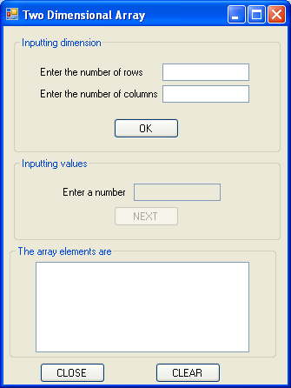
ReadOnly=True
Backcolor=White
Multiline=True

Slide 21

Dim a(,) As Integer = {{1, 2, 3}, {4, 5, 6}}
Dim i, j As Integer
For i = 0 To 1
For j = 0 To 2
txtArray.Text = txtArray.Text + " " + CStr(a(i, j))
Next
txtArray.Text = txtArray.Text + vbCrLf
Next

Slide 22

Public Class Form1
Dim arr(,) As Integer ‘2D-array declared
Dim i, j As Integer ‘indices of the array
Dim row, col As Integer
‘the total no. of rows & columns of the array
……………
End Class

Slide 23

Private Sub btnNext_Click(ByVal sender As System.Object, ByVal e As System.EventArgs) Handles btnNext.Click
arr(i, j) = txtValue.Text
txtValue.Text = ""
txtValue.Focus()
If i = row - 1 And j = col - 1 Then
btnOk.Enabled = False
txtValue.Enabled = False
For i = 0 To row - 1
For j = 0 To col - 1
ListBox1.Items.Add(arr(i, j))
Next
Next
End If
If (j < col - 1) Then
j = j + 1
Else
i = i + 1
j = 0
End If
End Sub
Going to the next column of a row
On reaching the last element, display the matrix.
Going to the next row
Starting from 1st element

